Slide 1

LUGGAGE HANDLER
MINI PROJECT IN C
S REVANTH KUMAR
1NH19CS149
SEC 3C

Slide 2
OBJECTIVES OF THE COURSE
The student shall be capable of identifying a problem related to the field of computer science and carry out a mini project on the problem defined.
The student should be able to design and implement an algorithm for the chosen problem statement.
Student should be able to design an appropriate data structure(s) and demonstrate all its operations in detail.

Slide 3
ABSTRACT
The main purpose of developing the project was to store all the information about the passenger’s luggage and help in reaching the luggage to the right passenger.
The software is capable of storing the passenger’s information while checking in and also delete the passenger’s data while checking out. This program displays the passengers in different flights with their respective destinations and bag weights.
My project is aimed at reducing the instances of lost bags, increasing the ability to track and report on baggage including weight changes to prevent theft and loss. Luggage handler can add, delete and feed information like name, age, flight number, destination.
We use a data structure for updating luggage one by one. This project can be used in Airports, Railway Station, Ports and even in hotels as it can help the luggage reach the right hands in a much faster way. Using data structures moreover, will help us easily locate luggage as we’ll know in which flight the luggage is present.

Slide 4
Problem statement and Objectives
Losing luggage is a problem people face time to time. The reasons might differ, you might forget to collect your luggage, your flight attendant types in a wrong destination code or your luggage is loaded into a wrong plane.
The main moto here is to keep track of your luggage. Luggage handler can add, delete, feed and search information like name, age, flight number, destination.
We use a queue data structure for updating luggage one by one. We can check in or check out using the luggage handler.
We can also display all the entries stored in the Luggage Handler and view them to gain information.

Slide 5
REQUIREMENTS
Processor : Intel i3 or above / AMD Ryzen 3 or above
RAM : 2GB
Hard Disk : 10 GB
Input device : Standard Keyboard and Mouse
Output device : 1920x1080 Resolution Monitor
Operating system : Windows XP or higher
C Compiler : CODEBLOCKS or any c compiler

Slide 6
queue
Queue is a linear structure which follows a First In First Out (FIFO) order.
Unlike stacks, a queue is open at both its ends. One end is always used to insert data (enqueue) and the other is used to remove data (dequeue).
A real-world example of queue can be a single-lane one-way road, where the vehicle enters first, exits first. More real-world examples can be seen as queues at the ticket windows and bus-stops.
Once a new element is inserted into the Queue, all the elements inserted before the new element in the queue must be removed, to remove the new element.

Slide 7
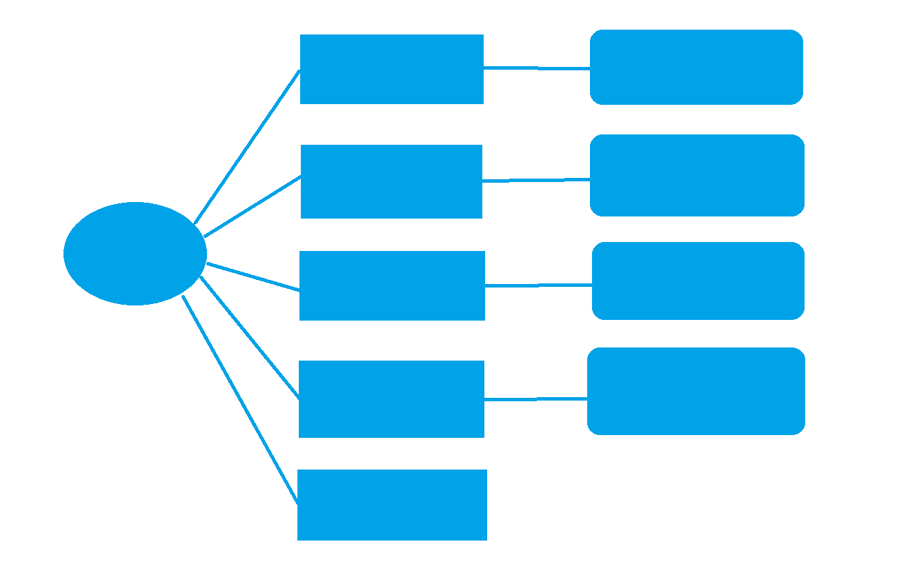
design
INSERT PASSENGER INFORMATION
ENTER AGE,NAME,DESTINATION,FLIGHT NO. AND BAG WEIGHT
DISPLAY PASSENGER’S INFORMATION
SHOW ALL PASSENGER’S DATA
Luggage Handler
ENTER PASSENGER’S NUMBER TO DELETE
REMOVE PASSENGER AFTER CHECKOUT
SEARCH FOR A PASSENGER’S LUGGAGE
ENTER PASSENGER’S NAME TO DELETE
EXIT

Slide 8
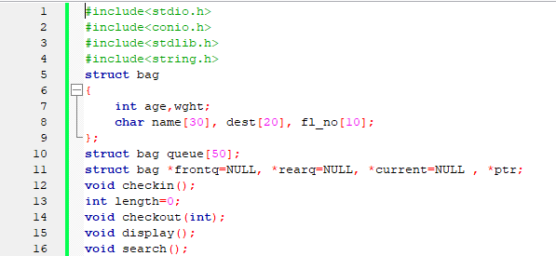
PROGRAM
First we’re include the necessary header files.
Create a structure bag, a structure is a user defined date type which allows us to combine data items of different kinds.
Declare the required functions like check-in, checkout, display and search.

Slide 9
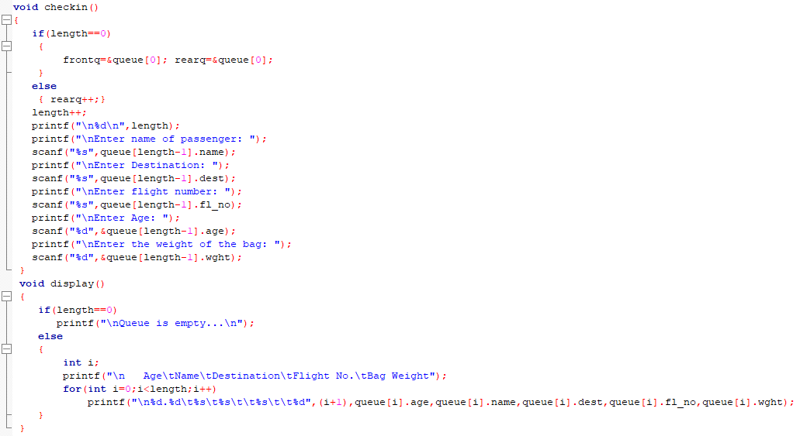
Check-in function:
Here, we’re collecting the required data from the user regarding there name, destination, flight number, age and weight of the luggage.
Display function:
Check if queue is empty or not. If not empty, display user entered data i.e. age, name, destination, flight number and weight.

Slide 10
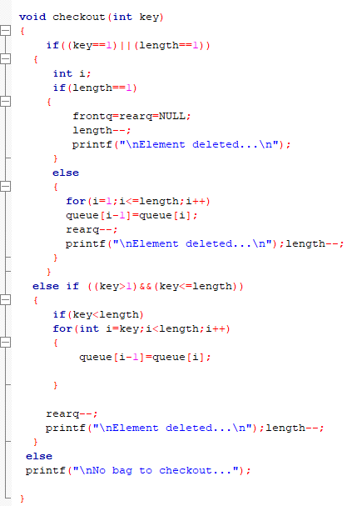
Checkout function:
Here, checkout is used to dequeue/delete user information from the database.
It also displays if queue is empty.

Slide 11
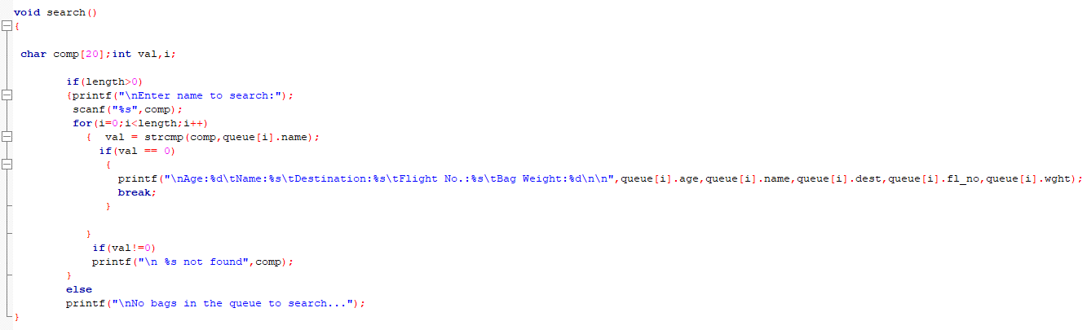
Search function:
This function asks for the passenger’s name and searches for the same in the queue and gives us the all the data like age, name, destination, flight number, and weight of the bag.

Slide 12
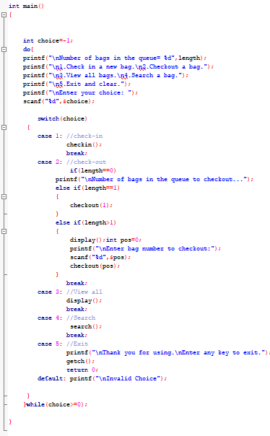
Main function:
When a C program is executed, the execution control goes directly to the main() function.
Here, we switch case to check-in, checkout, display, search and exit.

Slide 13
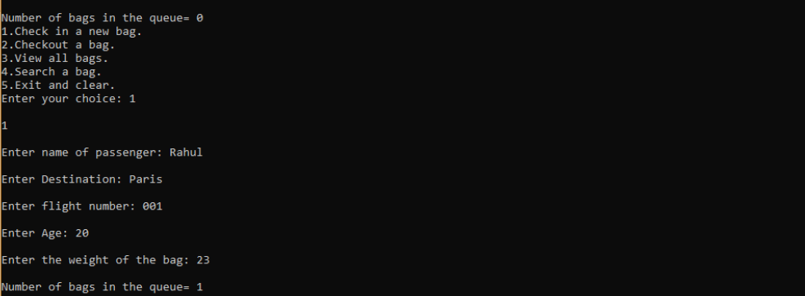
outputs
Insertion:
Data is inserted according to user information, like name, destination, flight number, age, weight of bag.

Slide 15
Display function, displays all the information.

Slide 16
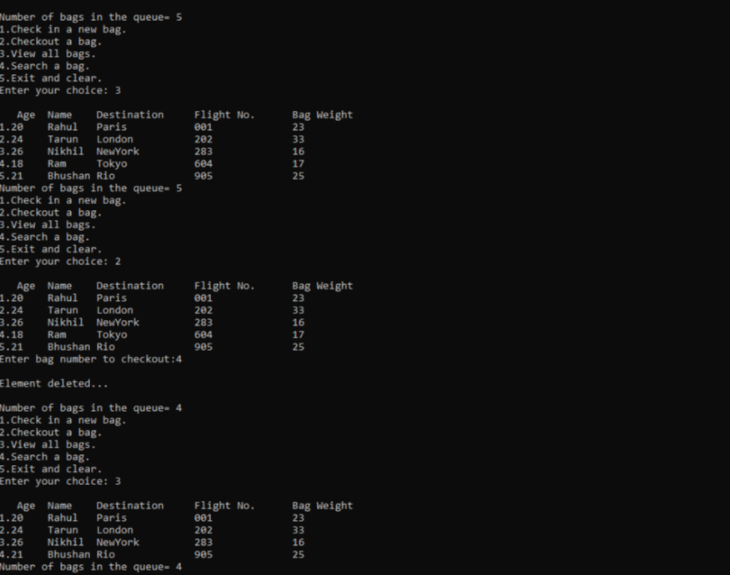
Delete function:
Deleting entry number 4 from the list of 5 entries.

Slide 17
After deleting entry number 4, we get the following list.

Slide 18
Search function:
Searching for data, we get the below results.

Slide 19
Conclusion
This program displays the passengers in different flights with their respective destinations and bag weights. We then provide a number for flight in which the luggage is placed, hence not being misplaced.
We can check in or check out using the luggage handler. We can also display all the entries stored in the Luggage Handler and view them to gain information.
This project can be used in Airports, Railway Station, Ports and even in hotels as it can help the luggage reach the right hands in a much faster way.

Slide 20

Thank You
S REVANTH KUMAR
1NH19CS149
III SEM
3C
NHCE

